Slide 1
Suggested Dropout Process and Procedures
Statutes, Form suggestions and the GED

Slide 2
Kansas Statutes
72-111(a)
  “Subject to the other provisions of this section, every parent or person acting as parent in the state of Kansas, who has control over or charge of any child who has reached the age of seven years and is under the age of 18 years and has not attained a high school diploma or a general educational development (GED) credential, shall require such child to be regularly enrolled in and attend continuously each school year…”
72-1111(a)(2)
  “…If the child is 16 or 17 years of age, the parent or person acting as parent, by written consent, or the court, pursuant to a court order, may allow the child to be exempt from the compulsory attendance requirements …”
Notes:
Fact Sheet

Slide 3
Kansas Statutes
72-111(b) (2)
  “…the child and the parent or person acting as parent attend a final counseling session conducted by the school during which a disclaimer to encourage the child to remain in school or to pursue educational alternatives is presented to and signed by the child and the parent or person acting as parent.…”
Notes:
Fact Sheet

Slide 4
Counseling Session Requirements
72-1111 (b) (2) – Required Elements
Information regarding the academic skills that the student has not yet achieved.
Difference between future earnings of a high school graduate versus a dropout.
District approved educational alternatives

Slide 5
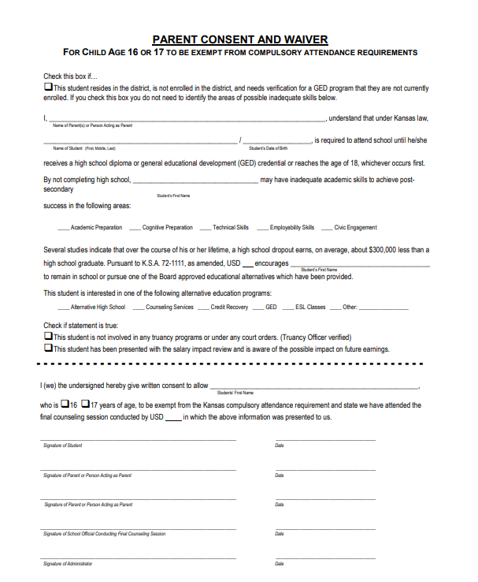
ww.ksde.org
Graduation page
Sample Compulsory School Attendance Disclaimer Form (commonly called “the waiver”
Districts may choose to edit or modify to fit local needs.
Academic
Earnings Difference
Alternative Programs

Slide 6

Required Elements
Identifying skills that may be lacking:

Slide 7
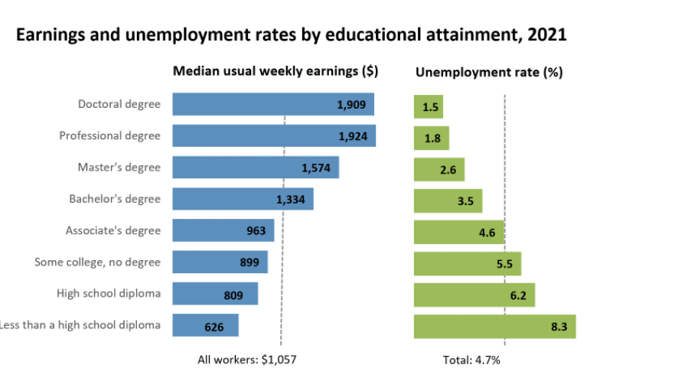
Required Elements
Earnings Difference:
Several studies indicate that over the course of his or her lifetime, a high school dropout earns, on average, about $300,000 less than a high school graduate. Pursuant to K.S.A. 72-1111, as amended, USD _______ encourages ____________________________________________ (student name)
to remain in school or pursue one of the Board approved educational alternatives which have been provided.
Education pays : U.S. Bureau of Labor Statistics (bls.gov)

Slide 8
Required Elements
Earnings Difference:
The Average Salary With Less Than a High School Diploma
Workers with less than a high school diploma are the lowest earners on average when you examine the average salary by education level. According to data from the Bureau of Labor Statistics (BLS), median weekly earnings in 2020 for those with less than a high school degree was $619. That works out to $32,188 per year, assuming a year of constant earning. The unemployment rate in February 2022 for Americans with less than a high school diploma was 6.6%, according to the St. Louis Federal Reserve Bank.
The Average Salary With a High School Diploma
Earnings are higher for those with a high school diploma. Median weekly earnings for workers with a high school diploma but no college was $781. That works out to $40,612 per year. The unemployment rate for those with a high school diploma is 7.1%.
The Average Salary by Education Level - SmartAsset
Notes:
.

Slide 9
Required Elements
Education pays : U.S. Bureau of Labor Statistics (bls.gov)
Assumes working 52 weeks a year for 40 years
Earnings Difference:
Education | Dropout | HS Grad | Some College | Associate’s Degree | Bachelor’s Degree
Weekly $ | $626 | $809 | $899 | $963 | $1334
Annual $ | $32.552 | $42,068 | $46748 | $50,076 | $69,368
Lifetime $ | 1,302,080 | $1,682,720 | $1,869,920 | $2,003,040 | $2,774,720
Difference (Dropout) (HS Grad) (Some) (Associates) (Bachelors) | X X X X X | $380,640 X X X X | $567840 $187,200 X X X | $700,960 $320,320 $133,120 X X | $1,442,649 $1,092,000 $904,800 $771,680 X

Slide 10
Required Elements
District Approved Alternatives:
Pursuant to K.S.A. 72-1111, as amended, USD ______encourages __________________________________to remain in school or pursue one of the Board approved educational alternatives which have been provided. This student is interested in one of the following alternative education programs:
____ Alternative High School
____ Counseling Services
____ Credit Recovery
____ GED
____ ESL Classes
Other: ________________

Slide 11
Compulsory Waiver for GED
*Can’t enroll in a GED program while enrolled in school
*16-17 year old (not enrolled, but living in your district), wants you to sign the waiver so they can enroll in a GED program.
Notes:
.

Slide 12
Compulsory Waiver for GED
If you sign the waiver for a student that hasn’t enrolled and doesn’t want to, but lives in your district, you ARE NOT responsible for that student in your four year cohort or as a dropout.
If you do NOT sign the waiver and allow the student to enroll in a GED program, the attendance and truancy policies should be utilized as you are responsible for them (72-1113(a)).

Slide 13
  Dr. Robyn Kelso
  Coordinator
  CSAS
  (785) 296-3444
  rkelso@ksde.org

